Slide 1
smallhead
BIGWISDOM

Slide 2
SOCIAL CLUB
Notes:
The main goal of this presentation is to provide English teachers with a wide range of relevant vocabulary that entails current events to be shared with their ESL’s students .
On the verge of your presentation's beginning, asking your audience what the topic of your presentation might be has turned out to be a great idea because it helps release the possible pressure when starting your lecture.

Slide 3
REVIEW
Notes:
The teacher can briefly review the previous topic by asking to some random students.

Slide 4
Mr A19
Maybe – Perhaps
Possibly - Probably
Notes:
"Mr. A 19" is a fictional character that is in charge of opening up your class by providing a quick but insightful grammar point.
This time is the subtle differences among possibly, probably, maybe and perhaps.

Slide 5
For starters, you should know that there are three levels of possibility:

Slide 6
“Probably" implies that something has a high probability
of happening - 50% or more.
“Possibly" implies that something has a low probability of happening
- 50% or less.
Notes:
If you CLICK on the green arrow, it will redirect you to the slide number 6, where you can show a couple of examples regarding the "probably" concept.
If you CLICK on the red arrow, it will redirect you to the slide number 7, where you can show a couple of examples regarding the "possibly" concept.

Slide 7
Probably
That's probably an incorrect answer.
They should probably be more grateful for the help received.
Notes:
If you CLICK on the green arrow, it will redirect you to the slide number 4, where you can find the definitions of the concept "probably".

Slide 8
Possibly
Maria could possibly come late tonight.
This is possibly the best bread I've ever eaten.
Notes:
If you CLICK on the red arrow, it will redirect you to the slide number 4, where you can find the definitions of the concept "possibly". If you don't need to review this concept, just go ahead with the next slide.

Slide 9
"maybe" or "perhaps" are used to express that something has the same probability of happening or not happening.

Slide 10
What's the difference between "maybe" and "perhaps", then?

Slide 11
"Maybe" is more informal:
A: Are you going to that game?
B: Maybe. And you?

Slide 12
"Perhaps" is more formal:
A: Would it be feasible to reserve a table for three instead?
B: Perhaps. Please, wait a moment.
Notes:
Before you move on to new topic, it would be a terrific idea if you ask your students to come up with a couple of examples so that you can evaluate how much they understood. If there is a negative consensus, you might be advised to provide more examples so your pupils understand once and for all.

Slide 13
STREET ART
Notes:
As the title suggests, you're going to focus your time talking, asking, debating, reviewing, fact checking on the topic: "Street Arts". The PPT features three forms of art in countries such as: Jerusalem, Korea and France.

Slide 14
Fl wer
Lamps

Slide 15
Pedestrians in Jerusalem’s Vallero Square can stop for some respite under these self-inflating, giant flowers.

Slide 16
Installed by HQ Architects in 2014 and titled “Warde”

Slide 17
These nine by nine meter flowers “bloom” when someone approaches or…

Slide 18
…when a tram is about to arrive, brightening an otherwise depressed part of the city.

Slide 20
Notes:
The red flower at the bottom has a hyperlink to a video featuring these flower lamps in Jerusalem. It is quite useful in order to get concepts internalized on students' minds, and also to provide a clear understanding of what has been teaching up to this point.

Slide 21
Murals
and
Rain

Slide 22
A group of designers from South Korea found a way to fight those gloomy days when it just wouldn’t stop raining.

Slide 23
Together with Pantone they brought back the colors to Seoul by creating huge vibrant paintings on the streets which appear when it’s raining.

Slide 24
Project
Monsoon
Inspired by South Korea’s culture of emphasizing the importance of the flow of rivers…

Slide 25
…the paintings utilize Korea’s topographical features that create a flow and puddle of rain water in every street to fill the streets with color and life.

Slide 29
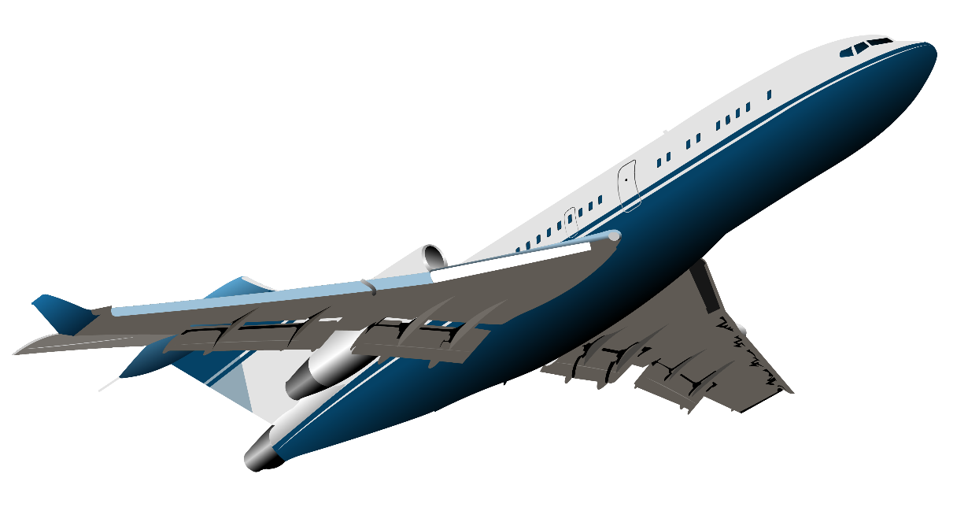
So, get a ticket to Seoul and grab an umbrella, because rainy days are nowhere near depressing there!

Slide 30
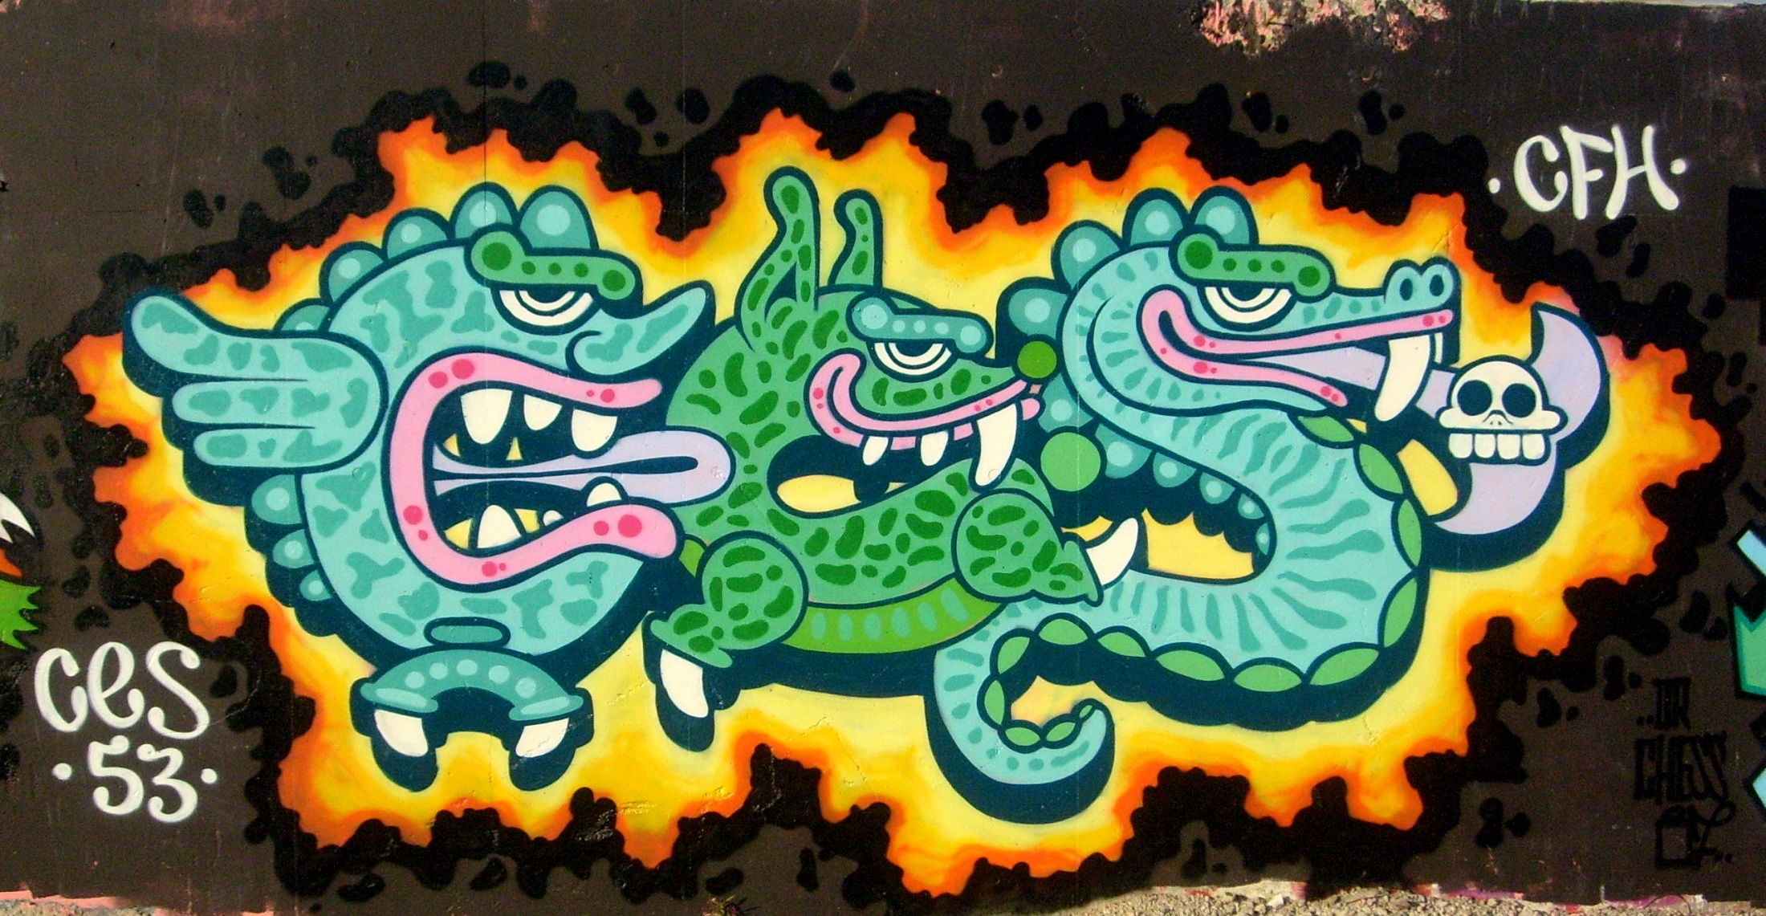
Legible Graffiti
Notes:
On this slide, the title's font " Legible Graffiti" was purposefully chosen to be illegible so you can explain what the terms "illegible" and "legible" mean. On the next slide, you can see the same title in a legible font.

Slide 31
Legible
Graffiti

Slide 32
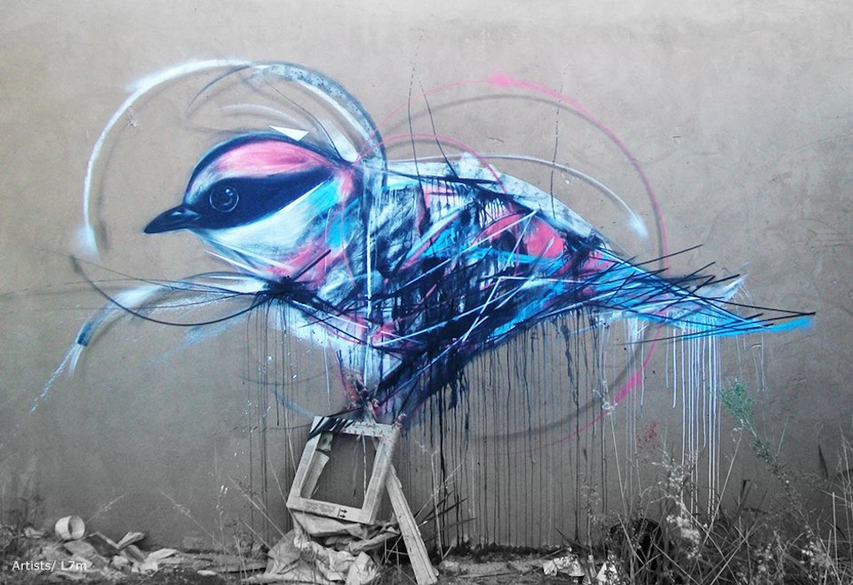
Graffiti can be beautiful or ugly…

Slide 33
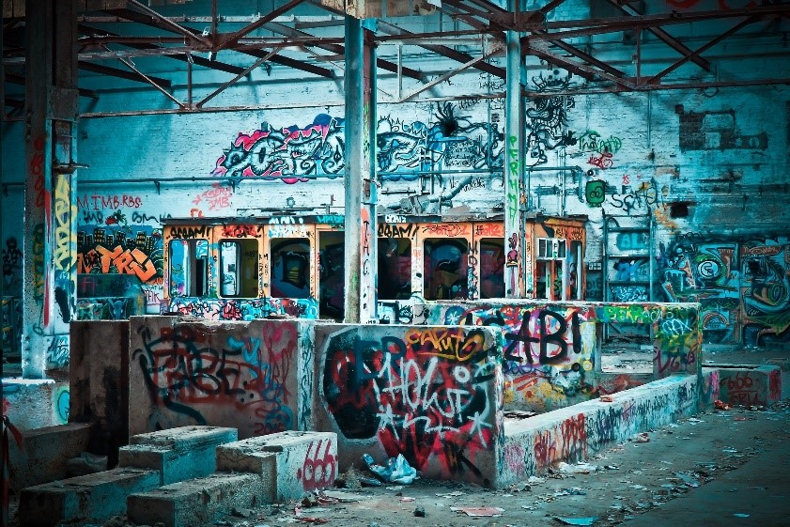
…but when it comes to tagging - most people would probably agree that it's the most hideous type of street art.

Slide 34
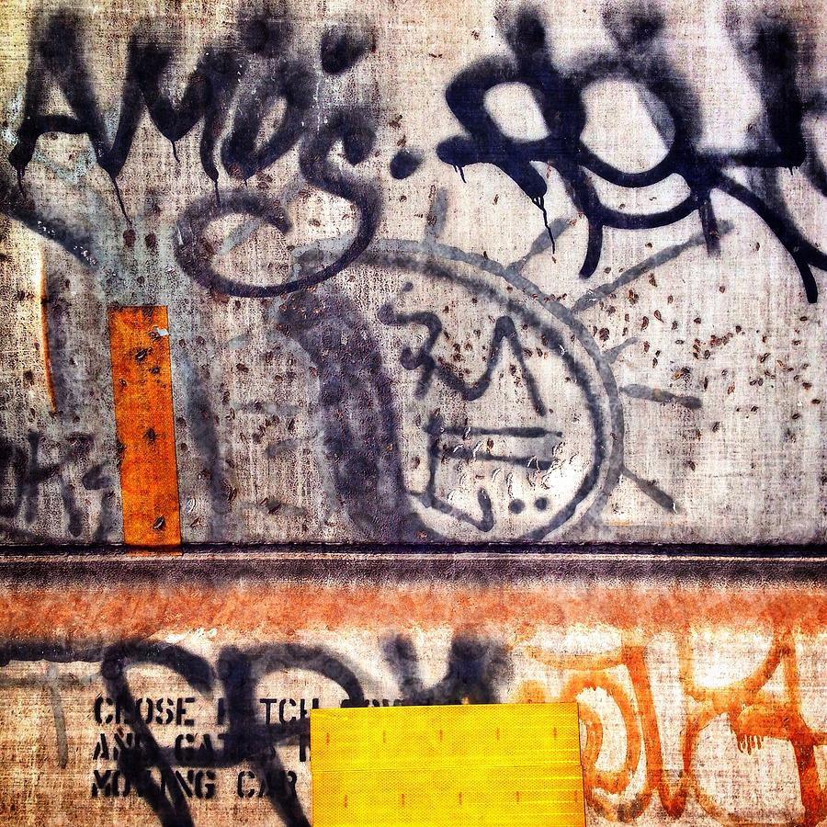
And what's even more annoying - it's almost always illegible.

Slide 35
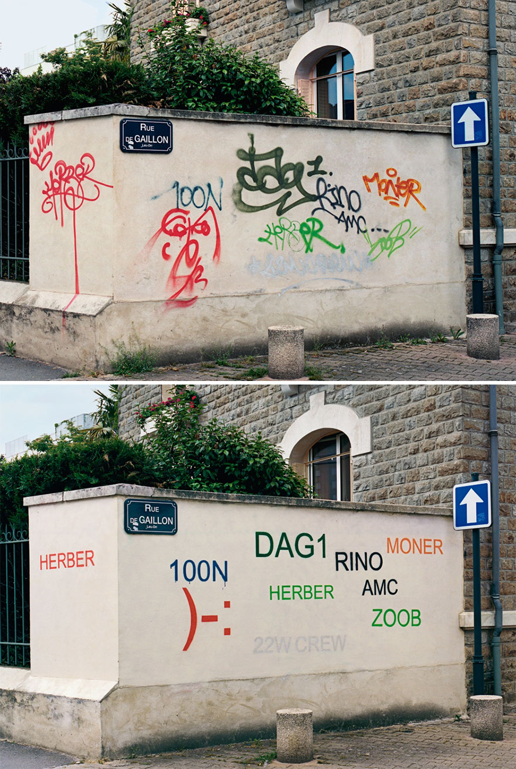
Mathieu Tremblin is a French artist who decided to fix this.

Slide 36
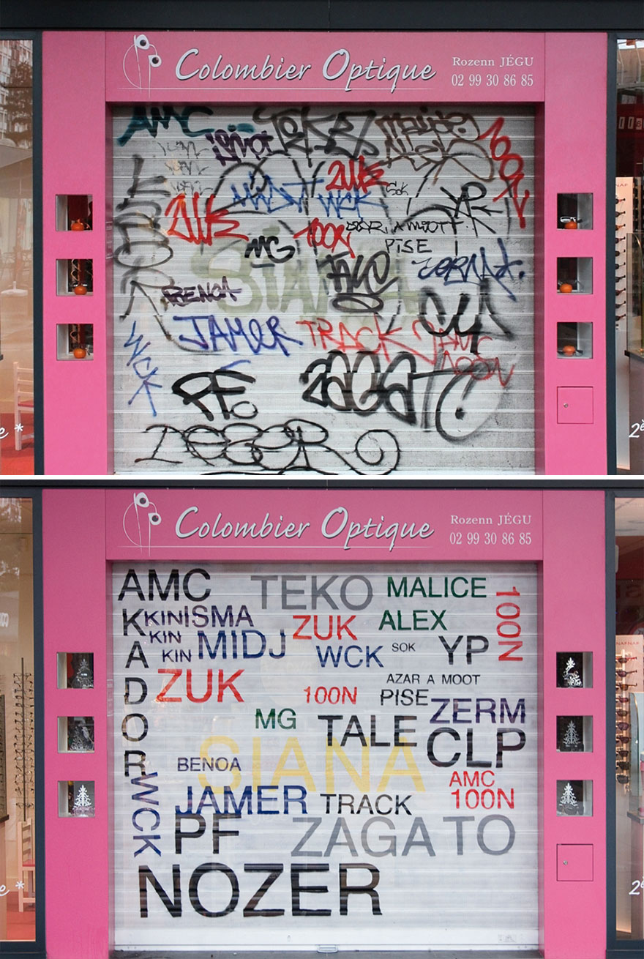
He paints over the ugly graffiti and makes them legible.

Slide 37
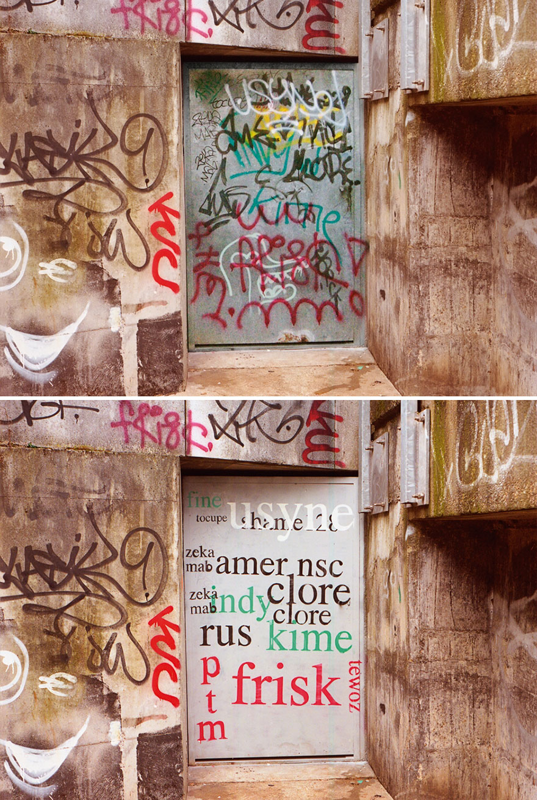
Tremblin’s interventions are a celebration of graffiti tags rather than a critique.

Slide 38
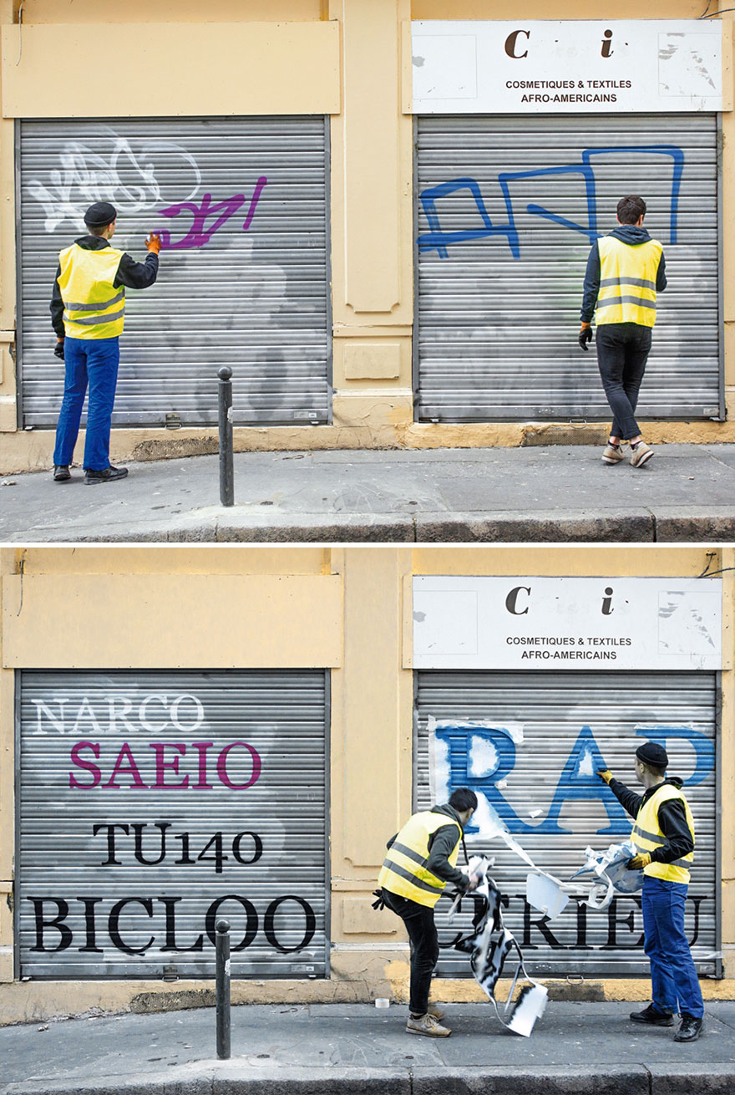

Slide 39
His work makes
a city more energetic, poetic and open to art evolution.

Slide 40
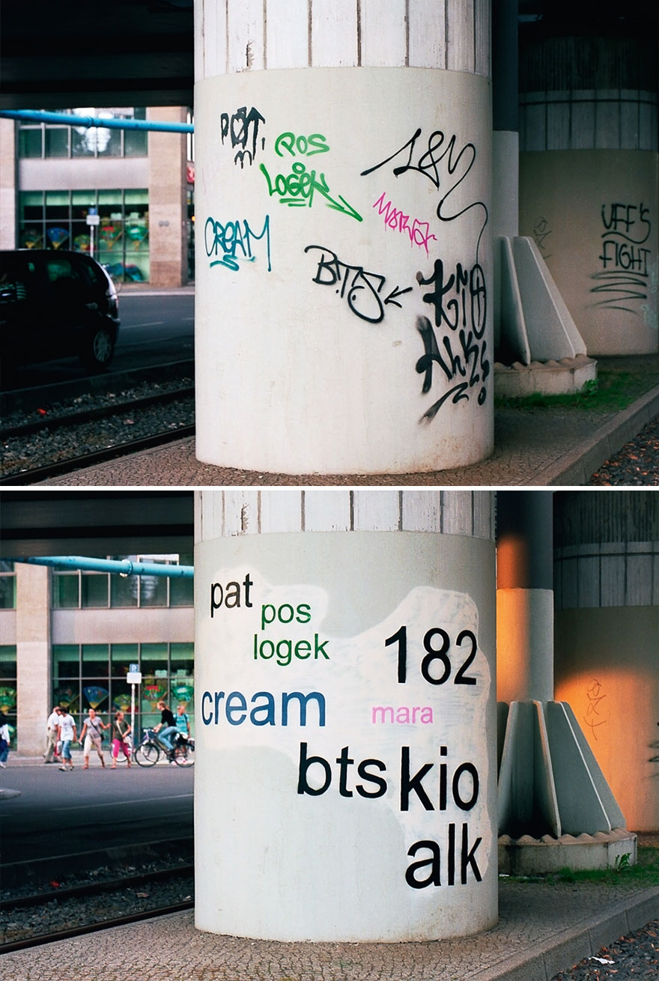
Hope you’ll love and appreciate his work.

Slide 42
smallhead
BIGWISDOM
Check for more!

